Slide 1
a Heterodox model?
Unpacking the Icelandic alternative
Oddný Helgadóttir
Brown University

Slide 2
Iceland as an alternative model?
“Nearly three years after the Icelandic economy imploded, the country appears to be recovering, and some believe its approach may offer a possible solution to Europe's debt problems.” –Justin Rowlett, BBC’s From our own correspondent
“As the first country to experience the full force of the global economic crisis, Iceland is now held up as an example by some of how to overcome deep economic dislocation without undoing the social fabric.”—IMF Survey Magazine
“I think I was one of the first econopundits to point out that Iceland, the poster child for financial excess, was actually having a surprisingly non-catastropic aftermath thanks to heterodox economic policies…at this point the Icelandic (relative) success story has become undeniable.”—Paul Krugman, New York Times Blog
Notes:
Following a complete financial collapse in 2008—the worst in history on a per capita basis—Iceland pursued a mixture of heterodox policies that have led to a return to growth and growing employment. As a result Iceland has been held up as a poster child for successful crisis management by everyone ranging from the IMF, mainstream media of varied political stripes, grassroots movements and civil society. It is framed as a rare success story in a continually depressing global scenario.
Different parties focus on different elements that may have contributed to the comparatively fortuitous outcomes in Iceland—anything from participatory democracy, to clean energy, debt forgiveness and capital controls.
This presentation takes a step back to assess the mixture of policies that were applied in Iceland, focusing in particular on the conditions that allowed Iceland to pursue heterodox policy choices in the aftermath of the crisis. If we are to think of Iceland as a model it is important to understand what allowed it to be a model, which elements may be replicable and which elements may not be.

Slide 3
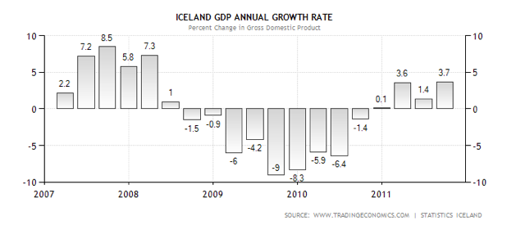
Outcomes: growth
Notes:
It is the argument of this paper that the policy mix pursued by Iceland did indeed lead to desirable outcomes, the likes of which have not been seen in other crisis-ridden European countries. For 2009 the IMF predicted a contraction of 10%, which in fact turned out to be on average 6,5%. There was a further average contraction of 3.5% in 2010 but 2011 witnessed a return to growth of an average of 3%, a trend which is ongoing this year. This, it should be noted, puts Iceland near the top of OECD growth performance and ahead of countries like Ireland and the Baltics, which have pursued more orthodox policies centered on austerity.

Slide 4
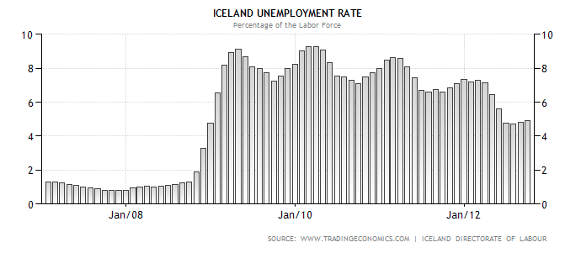
Outcomes: Employment
Notes:
What is more, employment outcomes have been good in Iceland. Before the crisis unemployment was just over 2% and it peaked at 9% in 2009. By late 2012 it was down to less than 5%. The only OECD countries with lower rates of unemployment are Norway, Switzerland, Austria, the Netherlands and Germany—and none of these countries experienced a serious downturn.
The distribution of costs of adjustment during the crisis has also been remarkably equitable. This has reversed the trend of growing inequality witnessed before the crisis. From 1995 to 2007 the after-tax Gini-coefficient rose from 0.21 to 0.43. By 2010 it was back down to 0.245.
All of these trends are enviable, especially in the context of the current international downturn. However, this paper argues that the policy choices that produced them were enabled by a very particular intersection of domestic and international processes driven by both material and ideational factors, many of which may be hard to replicate elsewhere. Nevertheless it is important to disaggregate and look at individual policies in turn to see what may be applicable in other crisis ridden economies.

Slide 5
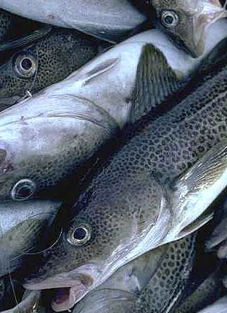
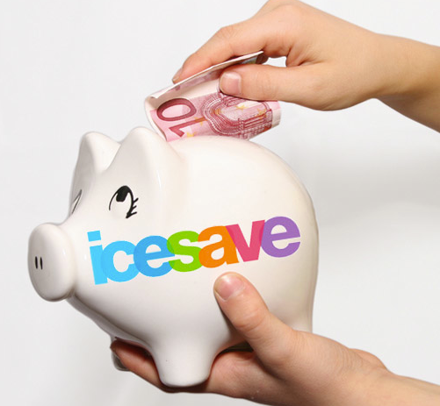
The backstory: from fisheries to finance
Notes:
In the late twentieth and early twenty-first century Iceland underwent a dramatic transformation. Within the space of a few years, and under the aegis of a government with deep neoliberal convictions, it was converted from a neo-corporatist social democracy specializing in commodity exports, mostly fish and aluminum, to an international financial center.
Iceland’s particular approach to financialization was characterized by high-risk private finance backed by state guarantees alongside conservative macroeconomic policies and light-touch regulation. A mixture of financial deregulation, privatization and high interest rates enabled Icelandic banks to grow at a dizzying pace at home as well as abroad. The three Icelandic banks—Glitnir, Landsbanki and Kaupþing—were originally state banks, which were gradually merged and privatized between 1997 and 2003, under a center-right coalition government.
Two key factors facilitated their rapid growth: first of all, the banks could expand their operations freely within the European Union, based on Iceland’s membership of the European Economic Area. Secondly, they inherited the good ratings of their state-owned predecessors. Stocks in Icelandic banks therefore had high ratings although the banks offered unusually high interests on deposits, making them, for a while, the “cheapest” banks in their rating class. The banks were sold to select domestic groups close to the ruling political parties, none of which had substantial experience in international banking.
The banks quickly began channeling vast amounts of credit into the economy and growing their own operations at a staggering rate. Between 2004 and 2008 lending increased by an average of almost 50% per year—and much of this was financed by intricate schemes of self-financing between the banks and their subsidiaries. A government inquiry into the causes of the crisis revealed the bogus financing of this kind accounted for 70% of the banks’ capital base.
The ensuing credit bubble saw the value of the stocks listed on the Icelandic Stock Exchange go up by a factor of seven in between 2002 and 2007 and the real estate market more than doubled in value. Right before the crisis the assets of the three banks were close to 1000% of GDP, making it completely impossible for the CB to act as a lender of last resort in the event of the crisis that was bound to follow.
For a few years Icelanders enjoyed newfound wealth – in 2007 average yearly incomes were almost $70,000 and because of the very highly valued Icelandic krona Icelanders with median wages could engage in patterns of consumption usually reserved for the very wealthy.
The warning signs that a crash was imminent went unheeded in the years before the crisis as Iceland was controlled by a small group of very powerful political actors that firmly believed in the benefits of liberalization.
Nevertheless, all of this came to a sudden stop in October of 2008.

Slide 6
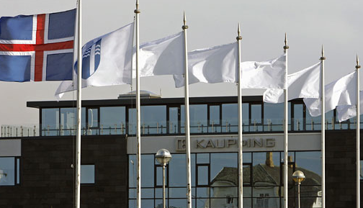
nationalization of banks and Capital controls
Notes:
As soon as access to credit became tighter following the collapse of Lehman Brothers the ill-managed and overleveraged Icelandic banks were underwater. The country’s entire financial sector went bankrupt in one week and there was no room for moderate or piecemeal reactions.
Two important policy choices which made Iceland’s recovery possible were made very early on: the first was to nationalize rather than bail out the banks. The second was to impose capital controls on outflows.
For the former, the limited resources of the central bank in the face of the banking crisis meant that a bank bailout was out of the question. It was out of this material constraint and not out of ideology that the conservative Icelandic government and central bank decided to nationalize the Icelandic banks and make investors rather than citizens bear the costs of bank failure. If the central bank had had the capacity to bail out the banks then it would have. In fact, it even took an early attempt at a bailout that failed utterly to drive this message home. Had Iceland been a member of the Eurozone and had access to ECB liquidity measures, it would have been much more likely to attempt to rescue its banks.
Secondly Iceland was able to impose capital controls for two key reasons. Firstly because it was not a member of the Eurozone and subject to its constraints and secondly because it received the IMFs blessing to do so. A rationalist perspective can also explain the fact that the IMF endorsed capital controls in Iceland. It was only through the adoption of capital controls that Iceland could avoid a catastrophic balance of payments crisis. Iceland’s finances were in such a state that other options were out of the question. Central bank rates were at an untenable 18% and the resulting carry trade meant that more than half of the central bank’s debt was held by foreign investors, eager to get out. As a result, letting the currency fall would have lead to a hyperinflation that, in turn, would have triggered a wave of private and corporate bankruptcies due to the widespread practice of inflation-indexed lending. What is more, the central bank’s funds were very nearly depleted. In the words of an IMF official working on the Icelandic case: “We just went down the checklist and this was the only possibility left.” In fact, the IMF not only endorsed this policy but initiated it and, informally, made aid to Iceland conditional on it, much to the dismay of some Icelandic politicians and bureaucrats. However, the IMF has also been careful to underscore that it thinks that Iceland’s situation is unique and that the same logic should not be applied elsewhere.
Timing matters a great deal when it comes to explaining the IMFs choice to put up capital controls in Iceland. The fall of 2008 was a transformational moment for many consequential policy actors. The IMF was no exception. In late 2008 research teams inside the fund prepared policy papers supporting capital controls as legitimate elements of crisis economics. This breach in IMF orthodoxy facilitated an alternative crisis paradigm for the Icelandic economy.
On October 24th a $ 2.1 billion IMF aid program for Iceland, alongside loan commitments from the other Nordic countries and Poland, was announced. This was the first time in over 30 years that a developed Western country received aid from the IMF and the situation was seen as very serious indeed. In the words of Poul Thomsen, the head of the IMF delegation to Iceland, this was “a perfect storm”. The country faced, all at once, a sovereign debt crisis, a currency crisis, and, relative to size, the biggest banking crisis in history. Iceland, then, presented an important opportunity for the IMF, which had lacked projects and faced questions of legitimacy, to prove its worth. Indeed, the IMF has capitalized extensively on Iceland’s relative success, all the while maintaining that the lessons that can be drawn from it are limited.

Slide 7
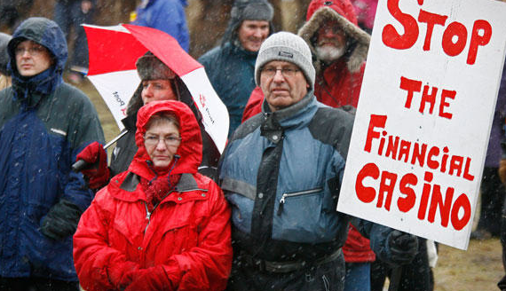
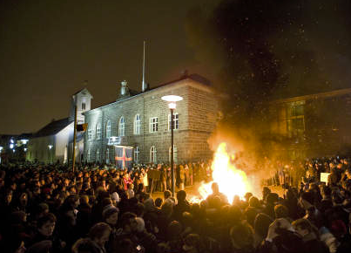
A change of government
Notes:
Importantly, following sustained popular protest the center-right government, which had been in power for a decade and half, was ousted and the first left-wing coalition in the country’s history took power. The new coalition was intent on preserving the welfare state and reversing many of the economic policies of the preceding decade. The Icelandic government was the only government in the world to resign in response to the crisis. The shift to a new left-wing coalition had a crucial impact on the policy choices

Slide 8
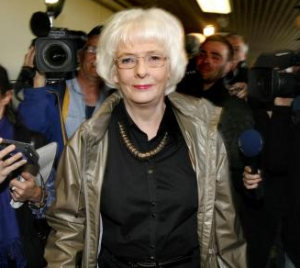
Choosing welfare
Notes:
Most importantly, however, popular mobilization stressed the importance of defending the welfare state and railed against converting private debt into sovereign debt. The anti-austerity demands were met by a Left Green-Social Democratic alliance led by a labor-oriented Social Democrat Jóhanna Sigurðardóttir. As a result, the government was able to negotiate the backloading rather than the frontloading of fiscal consolidation measures with the IMF and carefully orchestrated expenditure cuts and tax increases so that top income quartiles bore the brunt of the adjustments costs. This stood in sharp contrast to the content of IMF programs in Hungary, Latvia, Romania, Ireland, Greece and Portugal.
More specifically, the Sigurðardóttir government reached an agreement with the IMF not to pursue austerity measures in the first year of the program and to let automatic stabilizers operate in full. In the second year of the program public expenditure was reduced by 10%, but the cuts were accompanied by a shift to a more progressive tax code which included substantial tax hikes for top earners and various measures to bolster the shock to low and middle-income families. The combined result was that between 2008 and 2010 the real wages of the bottom tenth of the income distribution went down by 9%, while those of the top tenth decreased by 38%. Those at the middle of the income distribution, meanwhile, suffered a real wage loss of 14%. Much of this was the result of the depreciation of the ISK, which lost roughly half its pre-crisis value, and was therefore perceived as apolitical. The nadir was reached in mid 2010 but since then real wages have been rising, in sharp contrast to the situation in the PIIGS.
This is likely attributable to varied government measures which included scholarships to return to school, and higher wages for public servants. Most importantly, the government brokered a deal with the banks to allow for targeted debt forgiveness for homes and corporations, amounting in total to 13% of GDP. For example, homeowners burdened with high mortgages had debt written down so that it did not exceed 110% of the value of their property.
Furthermore, in a strategy that stressed the importance of increasing revenue, not just cut expenditures, the government increased the tax burden on the wealthy owners of fisheries despite a strike organized by the sector´s owners. These corporations had yielded astronomical profits to those holding the rights fishery quotas while producing little revenue for the state in spite of fisheries nominally being public property. In a move to maintain popular sovereignty over a strategic resource that can contribute to the long term fiscal sustainability of the budget, voters directly elected a committee to write a new constitution, which makes important changes such as making natural resources including fisheries and geothermal energy irrevocably public property. A referendum on the new constitution organized in October 2012 gave a massive popular endorsement to this proposal.

Slide 9
Lessons?
Iceland’s relative success is the result of a combination of structural and ideational factors as well as a confluence of fortuitously timed domestic and international processes that are difficult to replicate as a whole elsewhere
Important elements included:
  The scale of the disaster: banks couldn’t be bailed
  Being free of the constraints of the Eurozone while having access to the internal market
  The IMFs blessing to impose capital controls
  Popular protest
  A government dedicated to welfare politics
Notes:
This presentation aimed to show how the Icelandic approach to managing the crisis resulted not only in better growth and employment figures than we have seen in other crisis-stricken European states, but also created a more equal society.
What enabled the emergence of this alternative crisis resolution regime was the intersection of several external and domestic processes driven by both material and ideational factors at a fortuitous juncture. First, the scale of the banking collapse and the limited resources of the central bank and no access to ECB liquidity meant that a bank bailout was out of the question.
Secondly, Iceland could devalue its currency as it was not part of the Eurozone while maintaining access to European markets as a member of the EEA.
Thirdly, the IMF embraced capital controls in Iceland, likely due to a combination of timing and the scale and complexity of the Icelandic crisis.
Fourth, popular protest was so widespread and enduring that it could not be ignored. It ousted the right wing coalition in favor of a left wing coalition.
Finally, the new coalition was dedicated to protecting the welfare state and making the process of adjustment as equitable as possible.
In short, by refusing to bail out banks, pursuing progressive taxation, and making use of capital controls and currency devaluation, the Icelandic government gained room for maneuver that continental economies or Ireland did not have, as they face greater structural constraints as part of the Eurozone. The presentation also underscored that without a mobilized citizenry pushing for a more progressive settlement and the electoral victory of the left in the early days of the crisis, it is unlikely that the outcomes would have been the same.

