Slide 1
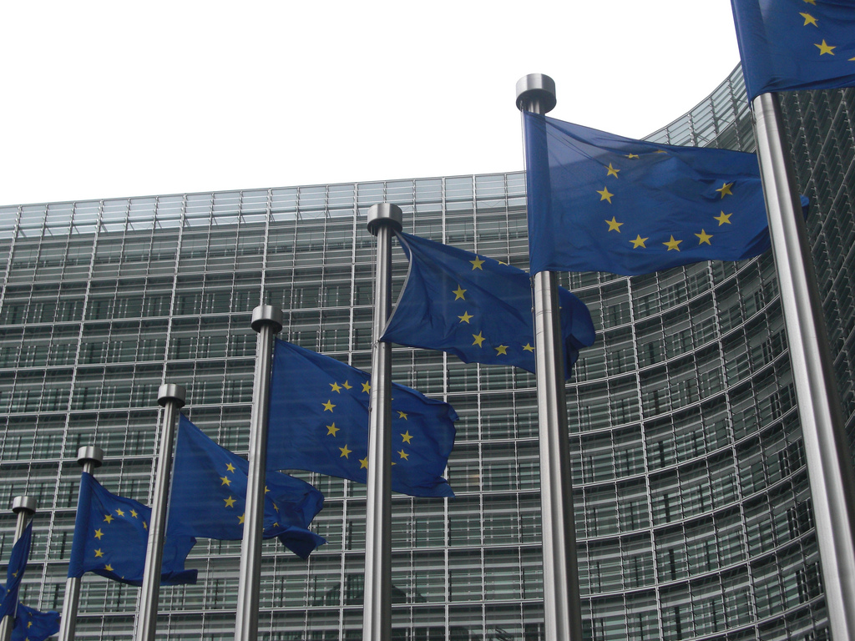

Beyond aid policies in Europe
Owen Barder

Slide 2
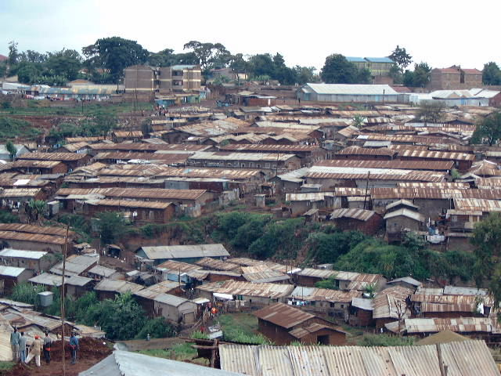
Rich countries can do more than aid

Slide 3
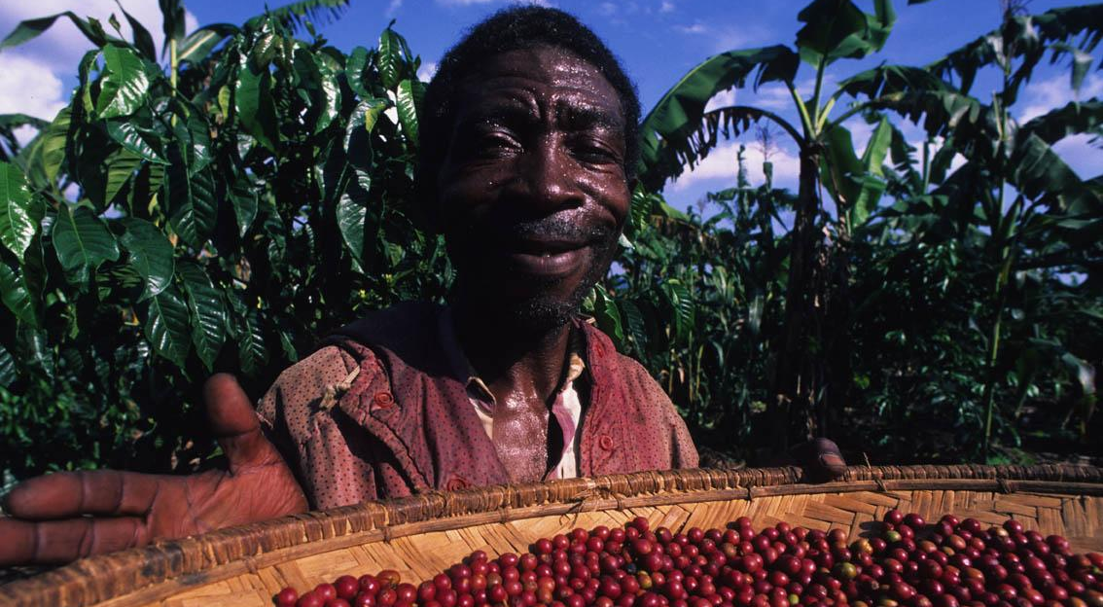
Removing trade barriers
gives poor countries access to markets and jobs

Slide 4
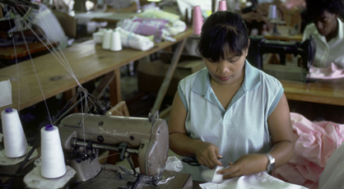
Encouraging investment
and fighting international bribery

Slide 5
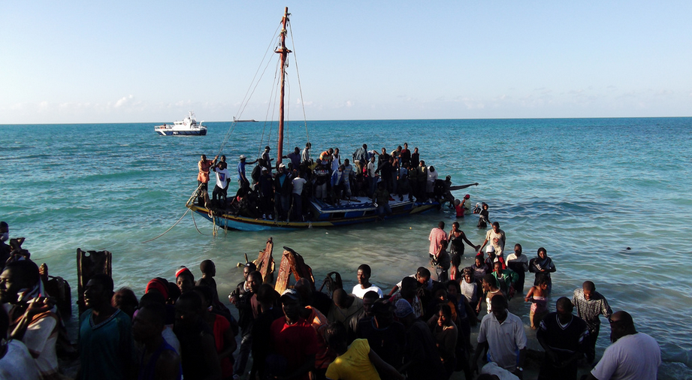
Allowing migrants
to seek higher-paying jobs and send remittances

Slide 6

Protecting the environment
and the global commons

Slide 7
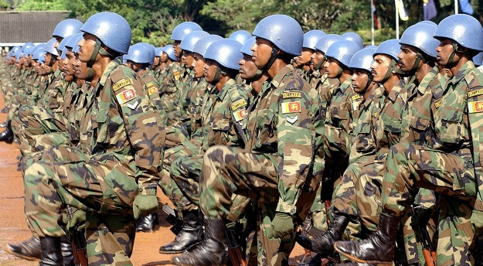
Fostering security
and protecting international sea-lanes

Slide 8

Disseminating technology
prompts innovation in developing countries

Slide 9
Beyond aid policies in Europe
Owen Barder, Center for Global Development in Europe

Slide 10
Development is about more than aid
TRADE
Lifting barriers to goods from poor countries
TECHNOLOGY
Incentivising R&D
Limiting intellectual property rights
INVESTMENT
Fighting international bribery
Political risk insurance
SECURITY
Peace-keeping
Protecting sea lanes
MIGRATION
Foreign students
Aid to regugees
ENVIRONMENT
GHG emissions
Preservation of biodiversity

Slide 12


Europe is not as good as expected

Slide 13
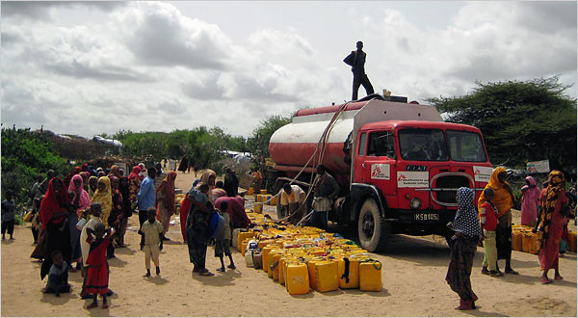
Europe tackles the symptoms of poverty

Slide 14
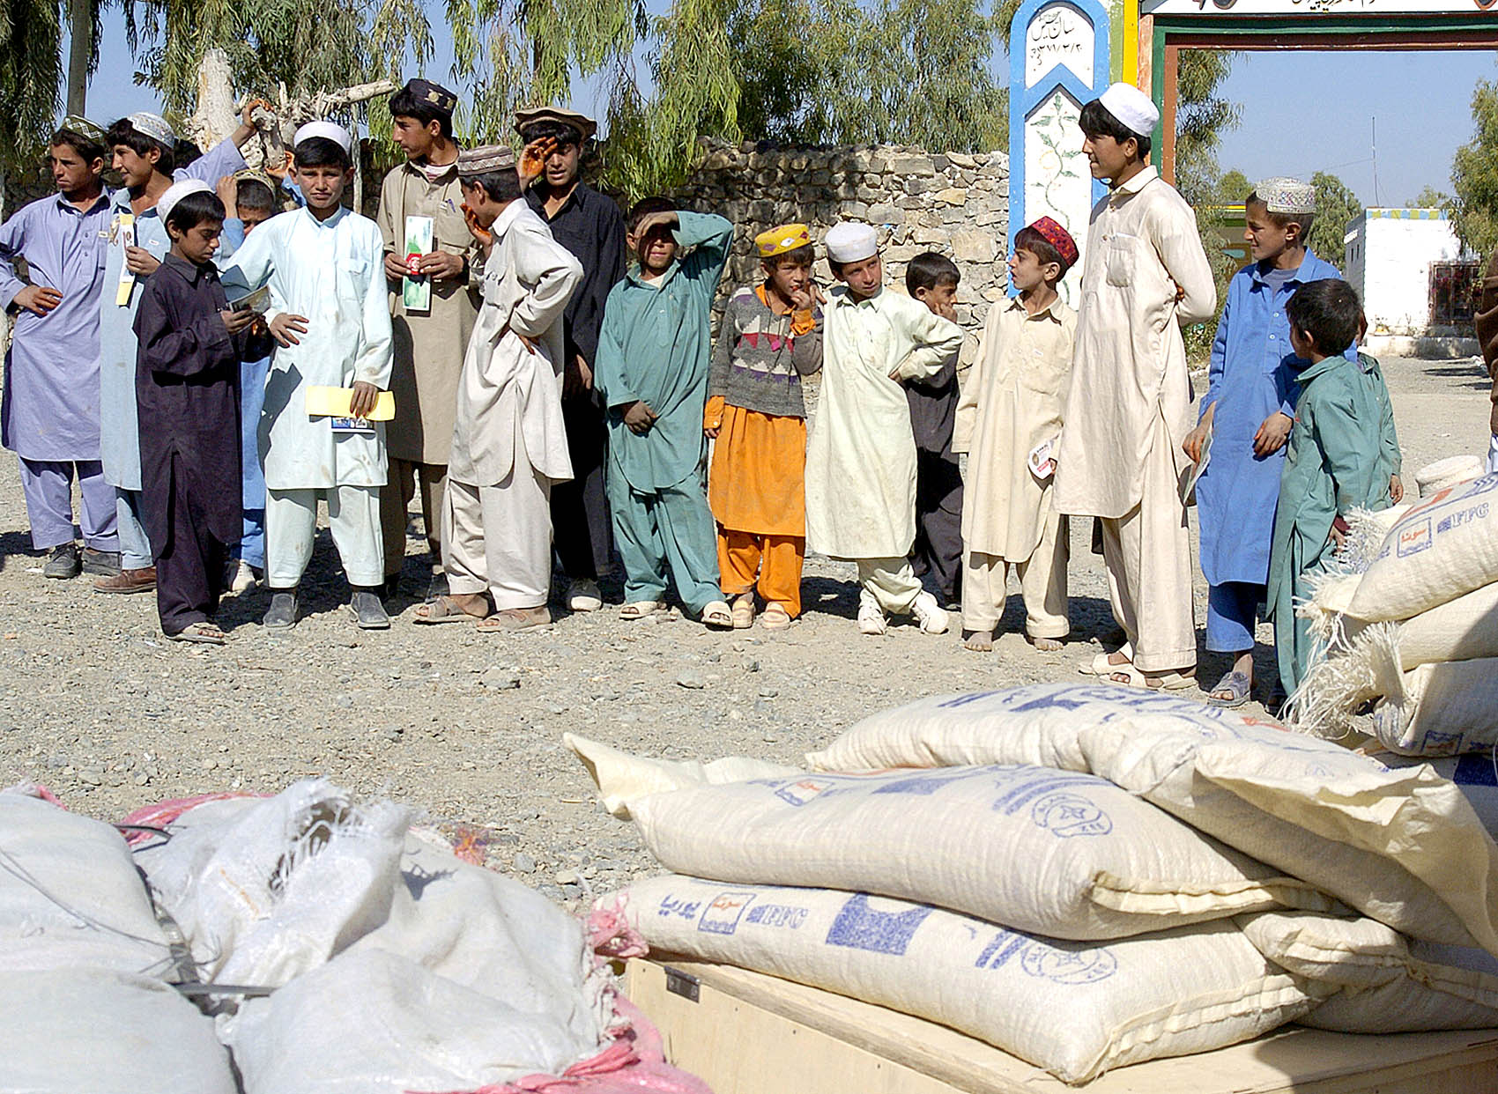
Europe tackles the symptoms of poverty

Slide 15
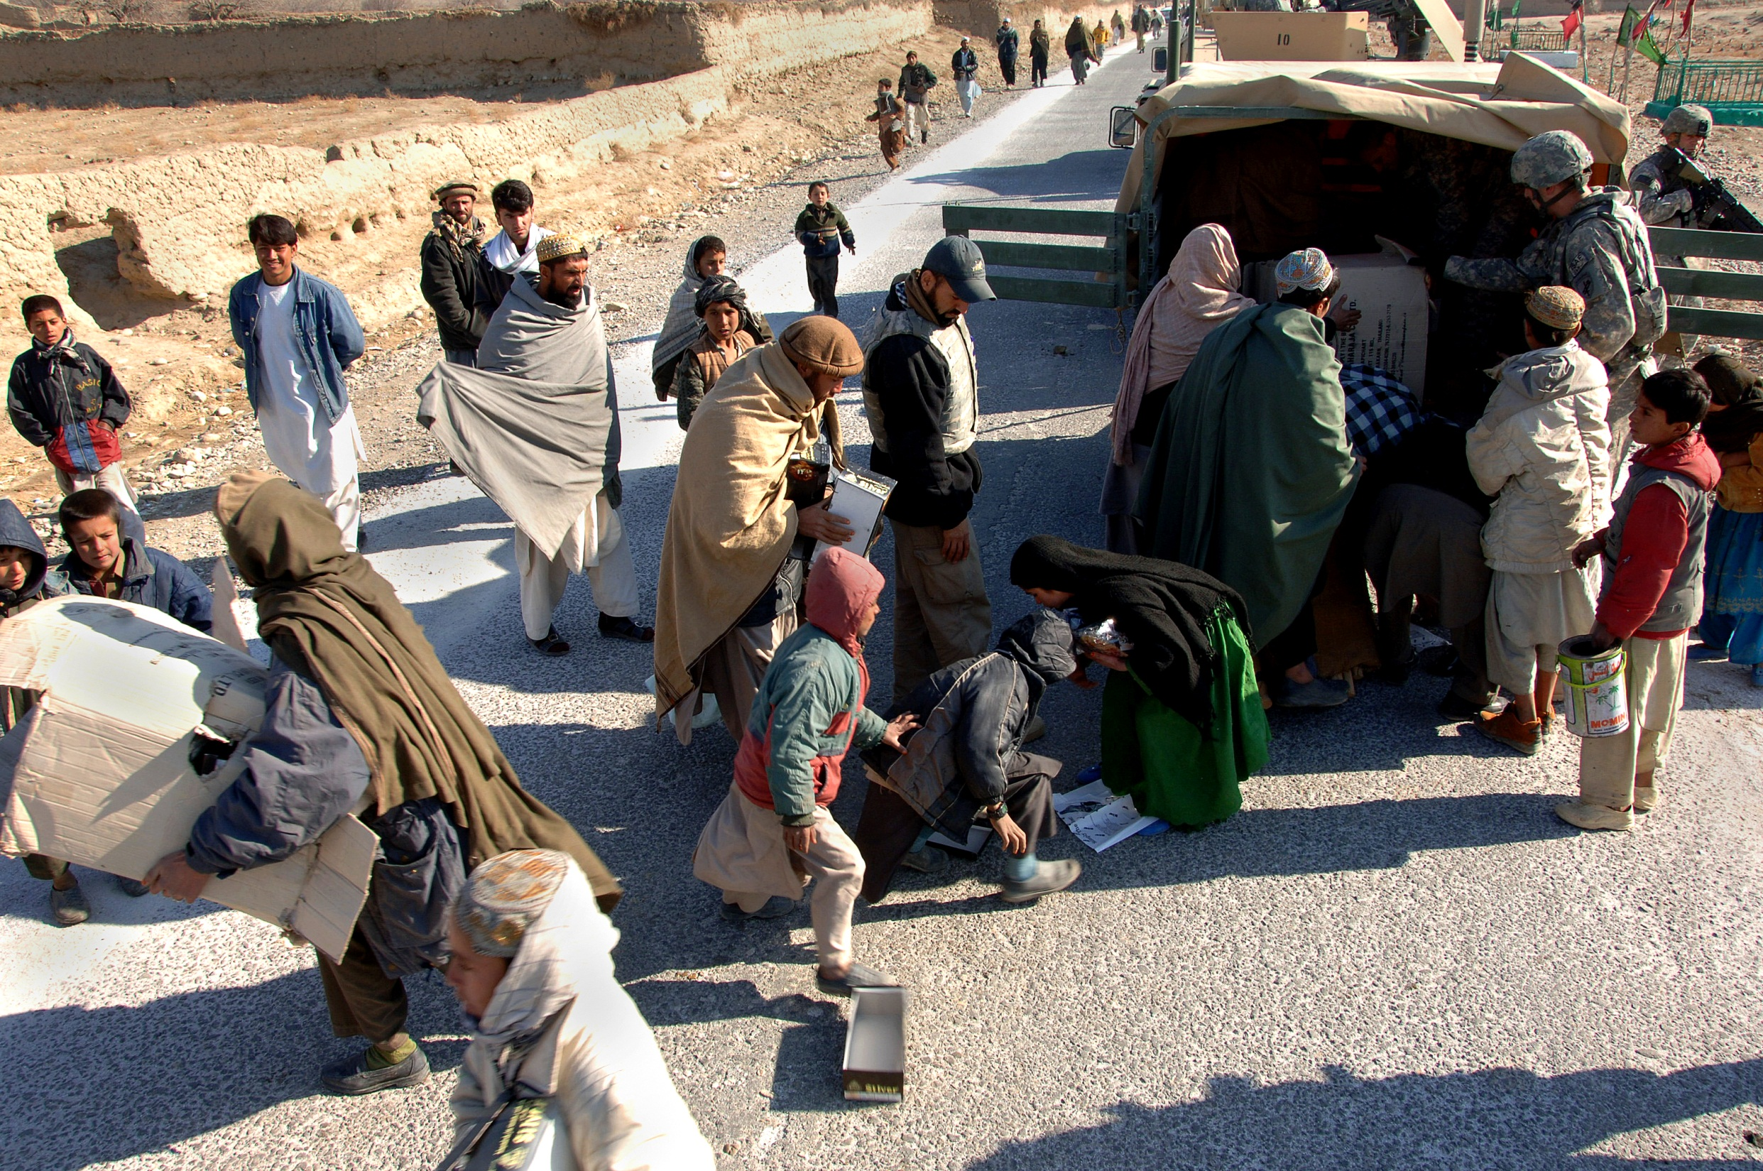
Europe tackles the symptoms of poverty

Slide 16
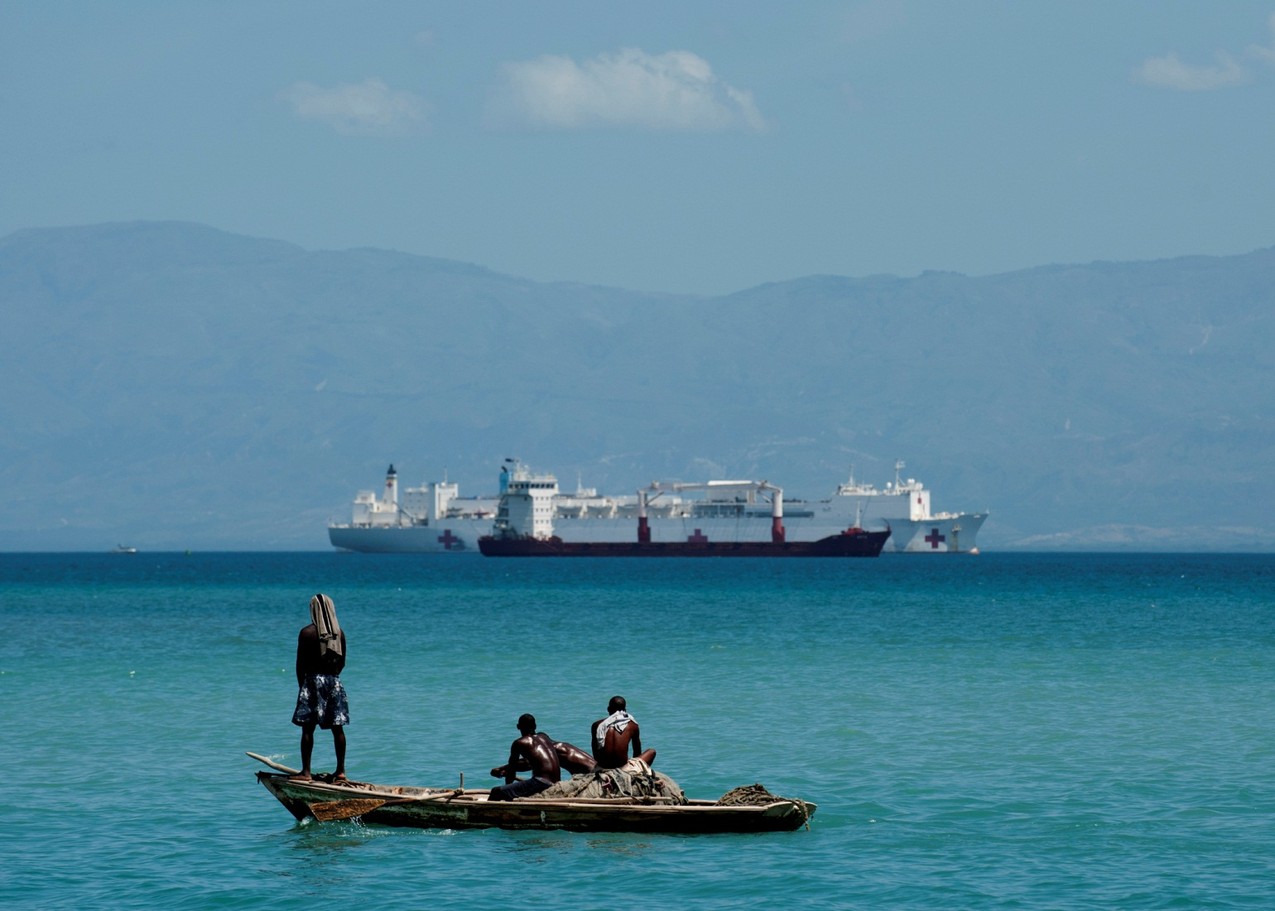
but could do better to address its causes

Slide 17
CDI Rank | Country | Score
1 | Denmark | 7.0
2 | Norway | 6.6
3 | Sweden | 6.4
4 | Luxembourg | 6.3
5 | Austria | 6.2
6 | Netherlands | 6.1
7 | Finland | 6.0
9 | United Kingdom | 5.7
10 | Portugal | 5.5
11 | Germany | 5.4
13 | Belgium | 5.3
13 | France | 5.3
15 | Spain | 5.2
17 | Ireland | 5.1
18 | Switzerland | 5.0
20 | Italy | 4.7
21 | Greece | 4.5
22 | Hungary | 4.0
23 | Slovakia | 3.8
24 | Czech Republic | 3.7
25 | Poland | 3.6
The top scorers are small countries…
while the more populous countries do relatively poorly.
average score

Slide 18

There is room for improvement

Slide 19

Thank you
cgdev.org/europe
@OwenBarder

