Slide 1

INTERNATIONAL DEVELOPMENT THROUGH ENTREPRENEURSHIP:
ISSUES AND CHALLENGES OF A CANADIAN NGO IN SOUTH AFRICA
Sophie Brière, Ph. D., Maripier Tremblay, DBA, Alain Daou
DSA Conference, November 2012
New forms of Development Partnerships
Panel 24, Case Studies

Slide 2
Introduction
Many studies in international development promote entrepreneurship as a mechanism for development(Lingelbach et al. 2005, Moyo, 2009, Naudé, 2011, Naudé et al., 2008, Nyambal, 2008) but entrepreneurship has long been absent from theories of economic development (Naudé, 2010)
The relationship between entrepreneurship and development is complex and more research is needed on the links between entrepreneurship, institutions, and development, especially in Africa (McMullen, 2011; Naudé, 2010)
Two logics converge: the market logic linked to the search for profit from private sector companies versus the humanitarian development logic inherent to non-governmental organizations (NGOs)

Slide 3
Question
What are the issues and challenges linked to the success of international projects focused on entrepreneurship development?

Slide 4
Theoretical Aspects
To our knowledge, limited empirical research has allowed for the establishment of a model to assess the benefits of international projects focusing on entrepreneurial development
Most of the literature addresses individual characteristics of entrepreneurs (Naudé et al., 2008), entrepreneurship attributes or company success (Firdaus et al., 2009), etc.
Actual research offers limited insight to analyse the success of international development projects aimed at supporting entrepreneurs (our research objective…)

Slide 5
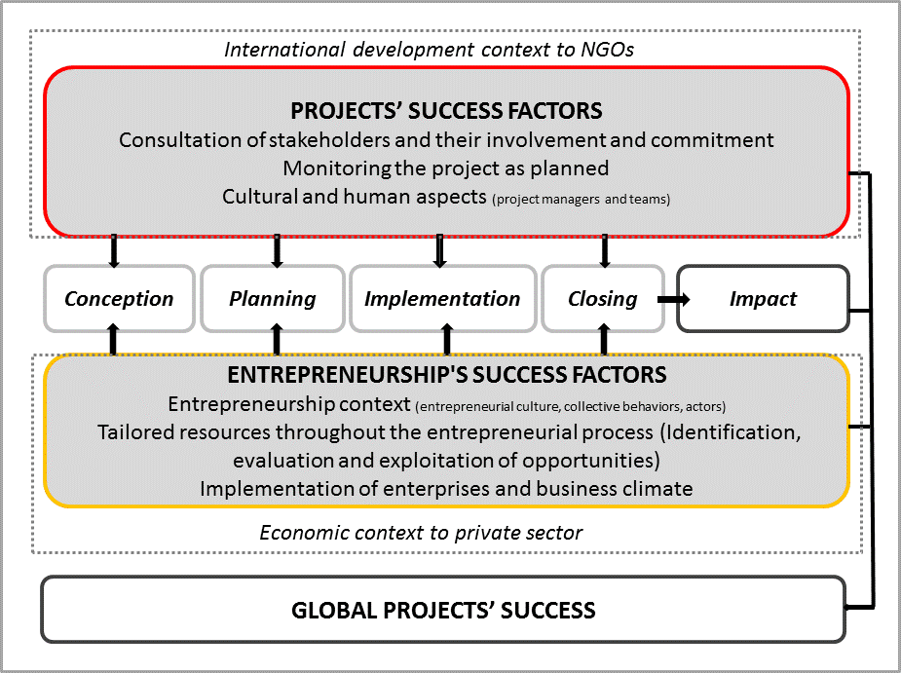
Theoretical Aspects
Projects’ success factors: Anantatmula and Thomas, 2010; Brière, 2010; Diallo and Thuillier, 2004; Khang and Moe, 2008; Lavagnon, 2007; Lavagnon, Diallo, and Thuillier ; Muriithi and Crawford, 2003)
Entrepreneurship’ s success factors: (Barès, 2004; Bosman and Gerard, 2000; Bloom et al., 2010; Bruhn et al., 2010; Carrier and Tremblay (2007) Gibb, 2005; Latha and Murthy, 2009; Mano et al. 2012; Wagle, 2007

Slide 6
Case Study
The case under study is that of Enablis, a Canadian-based, not-profit organization that supports entrepreneurs in the developing world
Created at the 2002 G8 Summit and founded by the Canada Fund for Africa, Accenture, and Telesystem, this NGO was financed by the Canadian International Development Agency (10 million $)
Enablis provides its entrepreneur members with networking, learning, mentoring and coaching services that will allow them to achieve self-sufficiency
Enablis projects aim to improve the skills of over 1,213 South African entrepreneurs (among which 36% are women and 73% are Black) and to create 6,040 new jobs (Bester, 2012)
Enablis South Africa consists of seven branches distributed on the territory and has a total of 20 employees

Slide 7
Case Study
The study was conducted in South Africa (Johannesburg and Cap Town)
The whole data collection took place between fall 2011 and summer 2012
A total of 33 respondents were interviewed (members of top management, entrepreneurs, partners and donors, employees, and people in the field)
The participant observation was conducted during a five-month stay in the organization
Various documents and archives were reviewed

Slide 8
Findings
The data analysis enabled the identification of four challenges and issues related to the implementation of an international development project aimed at supporting entrepreneurship:
  1) Transposing a northern business model into the South
  2) Developing local roots and contextualization of the NGO
  3) Achieving balance between resources allocated to project management and entrepreneurial services
  4) Finding a fit between private sector and international development cultures

Slide 9
Issue 1) Transposing a northern business model into the South
Project conceptualization not relying on a preliminary analysis of the needs on the ground/ “South Africa was chosen particularly as a first country because of its relatively more developed infrastructure” (founders)
Paradigm assuming that entrepreneurs do not differ depending on location/ “Entrepreneurship is innate and does not differ depending on location” (founders)
South African entrepreneurial culture to take into account/ “The biggest problems is cultural […] Our biggest problem is our education system […] in South Africa we've got a lot of people who are unemployable .” (SA Stakeholder)

Slide 10
Issue 2) Developing local roots and contextualization on the NGO
Change of mission in order to meet the community needs/ “At the beginning, it was specifically ICT […]And they listened to me, actually, which is good. Enablis would open up its membership to other sectors such as agriculture, tourism, services, transportation, logistics, whatever.” (donors)
Adapting to the cultural dimension of the organization’s various branches/“Even within South Africa you find that Cape Town does things slightly different than what Johannesburg does. So each city on its own also has its own different culture. I think that in Cape Town you can come to a meeting in flip-flops, where in Johannesburg guys wear a suit. (laughs)” (Enablis’staff)
Hiring local labour for the branches/“It really feels like whatever they have created, it's tailor-made for our situation, which is nice. It doesn't feel like something that's from Canada with Canadian solutions.” (Entrepreneur)
Local partners’ involvement and networking/ This involvement is particularly reflected by the Business plan competition, a local event specifically created by Enablis in South Africa

Slide 11
Issue 3) Achieving balance between resources allocated to project management and entrepreneurial services
Emphasis put on hiring people for administrative support and services provided to entrepreneurs by external resources/ “What would be nice is if we could focus more on entrepreneurs, internally. I would like to see an upscale staff capacity”. (Enablis’staff)
Service offering untailored to the entrepreneurs’ development level/ the necessity to be able to rely on more performing communication tools, particularly an updated and functional website and a membership database to maximize the impact of the organization’s services.

Slide 12
Issue 4) Finding a fit between private sector and international development
Duality between management approaches/ “They have never been able to understand: why do they need a gender equity policy, why do they need a result-based management, and all these things that a donor would actually insist on having. We forced them to do that […]but the problem is they never considered this to be of importance.” (donors)
Different views of the purpose and sustainability of projects/“The ultimate outcome is we want to get entrepreneurs rich […] we train job creators” (founders) VS “They are actually driven by things other than developmental objectives, right now” (donors)
Reconciliation of participants/“The characteristic of that project as something being pushed through, Canadian businessmen actually forced us to think differently”. (donors)

Slide 13
Discussion
Findings confirm the importance given by most authors to a preliminary analysis of the needs on the ground and to effectively consult stakeholders
This case study brings added value to the understanding of the specific contexts linked to international development and entrepreneurship
Findings show that several components must be adapted to local culture and illustrate the importance of endogenous practices in development
This research gives clear indications on how to perform this contextualization upon implementation: change of mission, hiring local labour, networking activities, involving stakeholders on the ground

Slide 14
Discussion
Achieving balance between resources allocated to project management and entrepreneurial services is part of the debate on the complexity of relations between entrepreneurship and international development organizations. This duality fuels the interest in studying this phenomenon with a managerial approach
Findings show the differences between international development and private sector cultures. Much work remains to be done in order for entrepreneurship and international development to be integrated on the ground
Results showed that much work remains to be done in order for the private sector and international aid stakeholders to contribute jointly to the creation of businesses that foster wealth distribution and better allocation of international aid (measure the efficiency and impact of entrepreneurship support programs according to indicators other than economical ones)

Slide 15
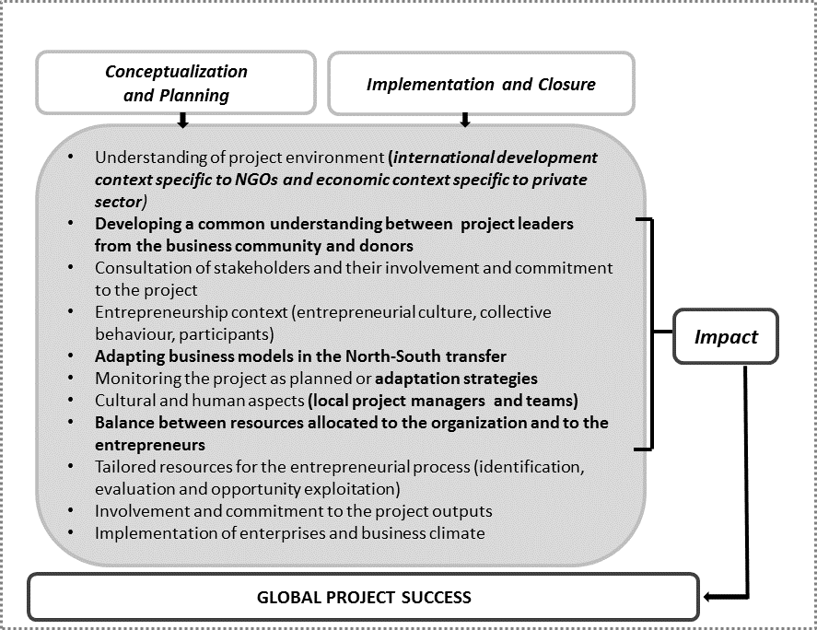
Model of Success Factors for International Development Projects of Entrepreneurship

Slide 16
Conclusion
While this case study is limited with respect to the generalization of its findings:
  At the practical level, this study provides indications on innovative organization-led projects, as Enablis, and for which considerable efforts are granted in often harsh environments as well as success criteria aimed at continuously improving their interventions.
  At the theoretical level, this case study paves the way to conduct other studies. These could result in following up with Enablis, since this organization set up chapters in other African countries, in conducting case studies with other organizations with a similar mission, or in validating different models presented as part of this research

