Slide 1
School of Earth and Environment
Sustainability Research Institute
The co-operative institutional form and
good governance:
the elephant in the room with rural poverty reduction
DSA Conference
Panel on Re-thinking Co-operatives
Rowshan Hannan, PhD Researcher
3rd November 2012

Slide 2
School of Earth and Environment
Sustainability Research Institute
Presentation outline
  Why this research
  The institution of co-operation
  Good co-operative governance
  Research methods
  Findings at the village level
  Conclusion and policy implications

Slide 3
School of Earth and Environment
Sustainability Research Institute
Why this research?
The co-operative contribution to poverty reduction is better understood now.
But how do co-operatives reduce poverty? And are some more effective at it than others?
Led to a focus on how co-operatives are run and operated → the co-operative institutional form and good governance.
Objective: To understand whether good governance in co-operatives impacts poverty outcomes (for both members and non-members)

Slide 4
School of Earth and Environment
Sustainability Research Institute
The Institution of Co-operation
Perceptions of reality
Development of internationally recognised co-operative principles and values
Enactment of national co-operative policies
Creation of global and national co-operative institutional structures

Slide 5
School of Earth and Environment
Sustainability Research Institute
Good co-operative governance
Co-operative governance → determines ownership and control of the co-operative, and is the mechanism for accessing and distributing wider benefits.
Members
Staff
Board of directors
Good co-operative governance includes a transparent, accountable and responsive connection directly from those involved in managing and running the co-operative to the membership.

Slide 6
School of Earth and Environment Sustainability Research Institute
Pathway from good co-operative governance to poverty reduction
good (coop) governance
access to coop
general members
democratic decision-making
Empowerment of poor women and men
staff
participation in voting
control
of coop
distribution of benefits
active participation in meetings
board members
poverty reduction at household and community levels

Slide 7
School of Earth and Environment
Sustainability Research Institute
Case study introduction
2 dairy farmer primary co-operative societies:
- one with good governance processes in place (Co-operative A)
- one facing a number of governance challenges (Co-operative B)
2 villages (Village A and Village B) with large numbers of members
14 member and non-member households
A five year period (2007 to 2012)

Slide 8
School of Earth and Environment
Sustainability Research Institute
Co-operative A | Co-operative B
Has a stable and well functioning governance structure | Has been facing a number of governance challenges since 2008
Has regular competitive elections, with a Management Committee of 9 members, each representing an electoral zone | Had an unstable Management Committee with regular resignations. Allegations of corruption. Vote of no confidence in May 2012 lead to dissolution of entire Committee and appointment of Interim Committee. All staff also dismissed
All AGMs and SGMs have reached quorum in the last 5 years | 15 meetings (AGMs and SGMs) have failed quorum in the last 5 years
Receives a number of new membership applications every month, with increasing active membership | Has not received any new membership applications in recent months, with declining active membership
Competitive payment rates to members with reliable payments made | Consistently low payment rates to members including failure to pay on time

Slide 9
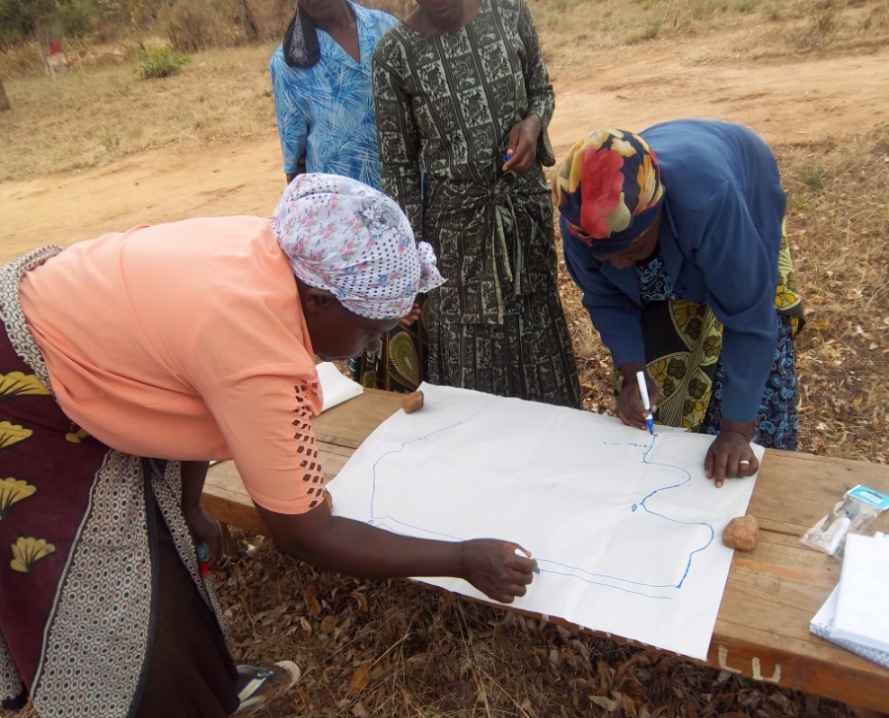
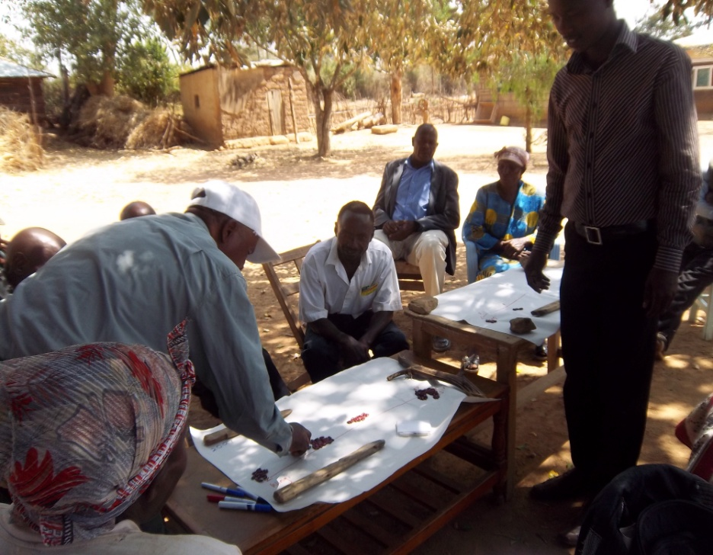
School of Earth and Environment
Sustainability Research Institute
Research Methods
Village level: participatory methods
Village resource mapping Wealth ranking

Slide 10
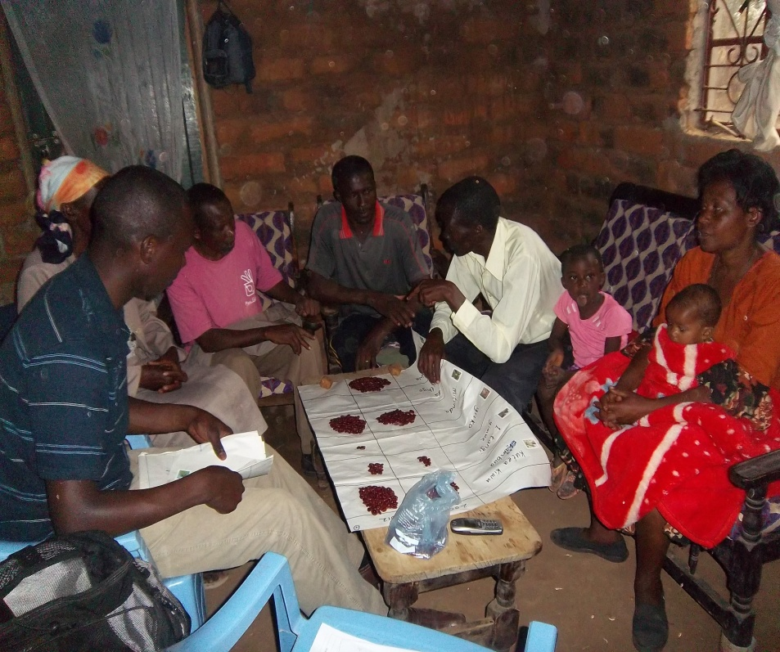
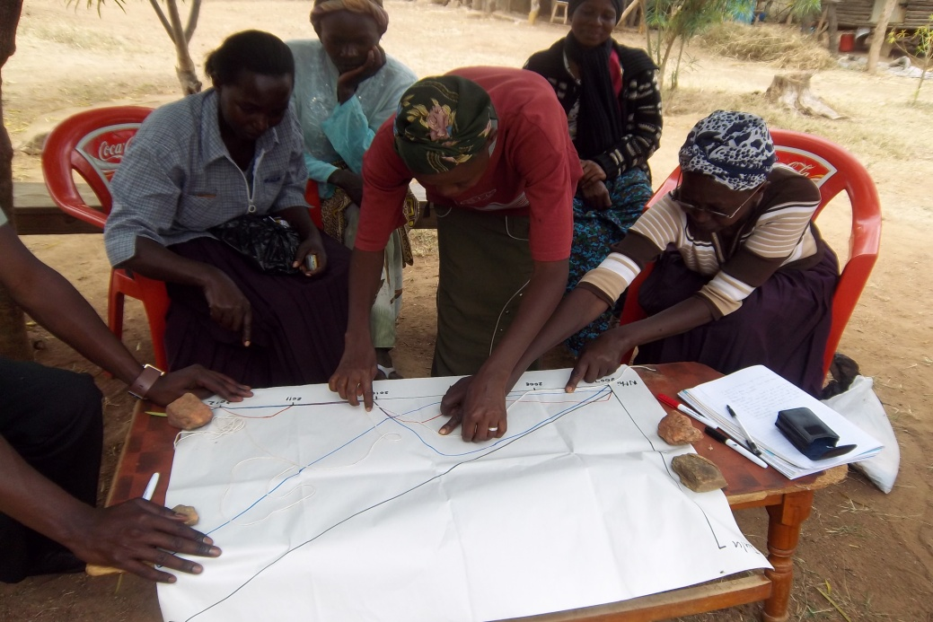
School of Earth and Environment
Sustainability Research Institute
Village resource scoring
Village trend lines

Slide 11
School of Earth and Environment
Sustainability Research Institute
Preliminary findings
Not yet analysed the data fully – very early findings
Village level findings
Wealth ranking exercises in Village A identified 70% of villagers to be in the poorest category in 2007 → reduced to 38% in 2012.
In Village B a reverse trend was found – with 10% considered to be in the poorest category in 2007 → increased to 60% in 2012.
In Village A, a greater level of equality was also found: 25% in the highest wealth category, 36% in the middle and 38% in the lowest.

Slide 12
School of Earth and Environment
Sustainability Research Institute
In Village A, one farmer explained why there were now fewer people than previously in the lowest wealth category:
‘People have been trained – agricultural training has meant
that dairy farming, fruit farming has gone up. Technology has also
advanced – through seminars we have learnt about different
methods of farming.’
Important role of co-operative in securing training by other service providers for both members and non-members → Co-operative A better able to negotiate and secure training in their membership area.
Less exposure to training in Village B.

Slide 13
School of Earth and Environment
Sustainability Research Institute
Co-operative A | Co-operative B
Close working relationships with main training providers (Ministry of Livestock, Ministry of Agriculture, private suppliers) → contribute to training organised by the co-operative | Has good working relationship with Ministry of livestock only
Village A familiar with training providers and confident to approach and demand training from them on their own | Perception of villagers that training providers are unapproachable
Successfully mobilised groups in the village (VSLAs), which were demanding their own training from the Ministries | Lack of confidence in the co-operative meant that members were not keen to participate in co-operative based activities
Committee representative for the area actively organising farmer-to-farmer training, and notifying members and non-members of trainings to be held | Interim Committee members do not represent any specific area. The 2 previous committee representatives for Village B resigned after short periods in office

Slide 14
School of Earth and Environment
Sustainability Research Institute
Village A | Village B
200% increase in the number of homesteads with women generating an income since 2007 | 100% increase in the number of homesteads with women generating an income since 2007
300% increased fruit production since 2007 | 35% increased fruit production since 2007
100 increase in poultry ownership since 2007 | No change in poultry ownership since 2007
37% of homesteads use fuel efficient stoves | 2.5% of homesteads use fuel efficient stoves

Slide 15
Sustainability Research Institute
Sustainability Research Institute
Dairy cow ownership
Since 2007 dairy cow numbers changed significantly in both villages:
Village A → dairy cow ownership increased by 400%
Village B → dairy cow ownership decreased by 50%
Farmers in Village A explained how the co-operative had shown villagers the potential to earn a regular income from dairy farming

Slide 16
School of Earth and Environment
Faculty of Environment
Co-operative member-specific benefits
Better dairy farming practices found amongst members in Village A as a result of:
    Better access to training and knowledge on dairy farming
    Access to credit in co-operative farm inputs store
Village A | Village B
50% average increase in member milk production since 2007 | 25% average increase in member milk production since 2007
Longer period of milk production throughout the year | Lower number of months a year when cow is milked
Lower losses of cows amongst members in 2009 drought | High levels of cow deaths amongst both members and non-members

Slide 17
School of Earth and Environment
Sustainability Research Institute
Income benefits
Co-operative A pays a higher price per litre of milk on average than Co-operative B.
Co-operative A pays higher dividend payments against shares than Co-operative B.
Co-operative A consistently pays advances to members on request; Co-operative B has not always been able to pay advances.

Slide 18
School of Earth and Environment
Sustainability Research Institute
Conclusion
Co-operatives are clearly important players in rural poverty reduction.
They should not be seen as vehicles for poverty reduction, but understood as emerging from the institution of co-operation with their own set of values and principles.
Their institutional form should be recognised and worked with to more effectively impact poverty outcomes → the importance of good co-operative governance.
Preliminary findings validate the pathway from good co-operative governance to poverty reduction.

Slide 19
School of Earth and Environment
Sustainability Research Institute
Policy Implications for partners working with co-operatives
Partners should recognise the distinctive co-operative institutional form and the governance structure at its centre.
This means respecting their autonomy, independence and decision-making processes → co-operatives are there to serve member needs, and meet member priorities.
Partners can easily undermine co-operative governance by imposing their own priorities.
Strengthening co-operative governance will help the co-operative to more effectively reduce poverty.

Slide 20
School of Earth and Environment
Sustainability Research Institute
Policy Implications for national co-operative movements
National policies often support co-operatives as enterprises and their role in the national economy.
Policies should also recognise the important role of co-operatives in mobilising people and allowing them to demand and receive services from others.
The role of co-operatives in allowing people to define and direct their own development.

