Slide 1
Theories of Change and Power Analysis
- just another fuzzword?
Duncan Green
DSA
November 2012

Slide 2
Why Theories of Change Matter
Rich source of new ideas and approaches in both advocacy and programming
Recognizing our own models of change and understanding those of others is helpful in building alliances
Improved agility and impact e.g. spotting opportunities quicker
Increasingly required by funders

Slide 3
Oxfam’s emerging Theory of Change
Across Advocacy, long-term development and (a bit) humanitarian
Active citizens (esp women) and accountable states
Oxfam often operates in the space between
Power analysis as the universal starting point
Coalitions (horizontal and vertical)
Critical junctures and conflict

Slide 4
What is Power?
Power as force field
Ways of looking at power
  Visibility: Visible, Invisible, Hidden
  Spaces: Intra-elite, invited, created
  Four powers: Within, With, To, Over
  The 3 ‘i’s: Ideas, Interests, Institutions

Slide 5
The power and change cycle
Power Analysis
Change Hypothesis
Implement and Evaluate
Select Change Strategies

Slide 6
Power Analysis
Needs to list the players (including the non-obvious ones)
Identify blockers and shifters as well as drivers
But also consider the dynamics –champions, alliances; how power can shift

Slide 7
What is your change hypothesis?
Peaceful or conflictive?
Within the existing institutions/system or disruptive?
Who are the drivers/blockers/shifters?
What persuades (research, pilots, peer pressure, internat pressure, pop mob)?
Steady change or discontinuous?
  Are shocks likely to be important? If so, how do we plan for them?

Slide 8
What is your change strategy?
What coalitions/alliances? Horizontal or vertical (usual suspects or unusual)?
  Civil society organizations
  Sympathetic state bodies
  Private sector, intellectuals, judges, faith leaders, media – who’s influential?
Importance of implementation gaps, eg around legislation
Political windows of opportunity (elections, changes of leadership, scandals)

Slide 9
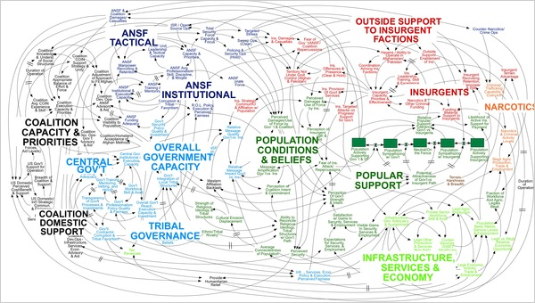
But remember, real life is complex

Slide 10

And don’t forget to come and help launch From Poverty to Power at 6.30!

