Slide 1
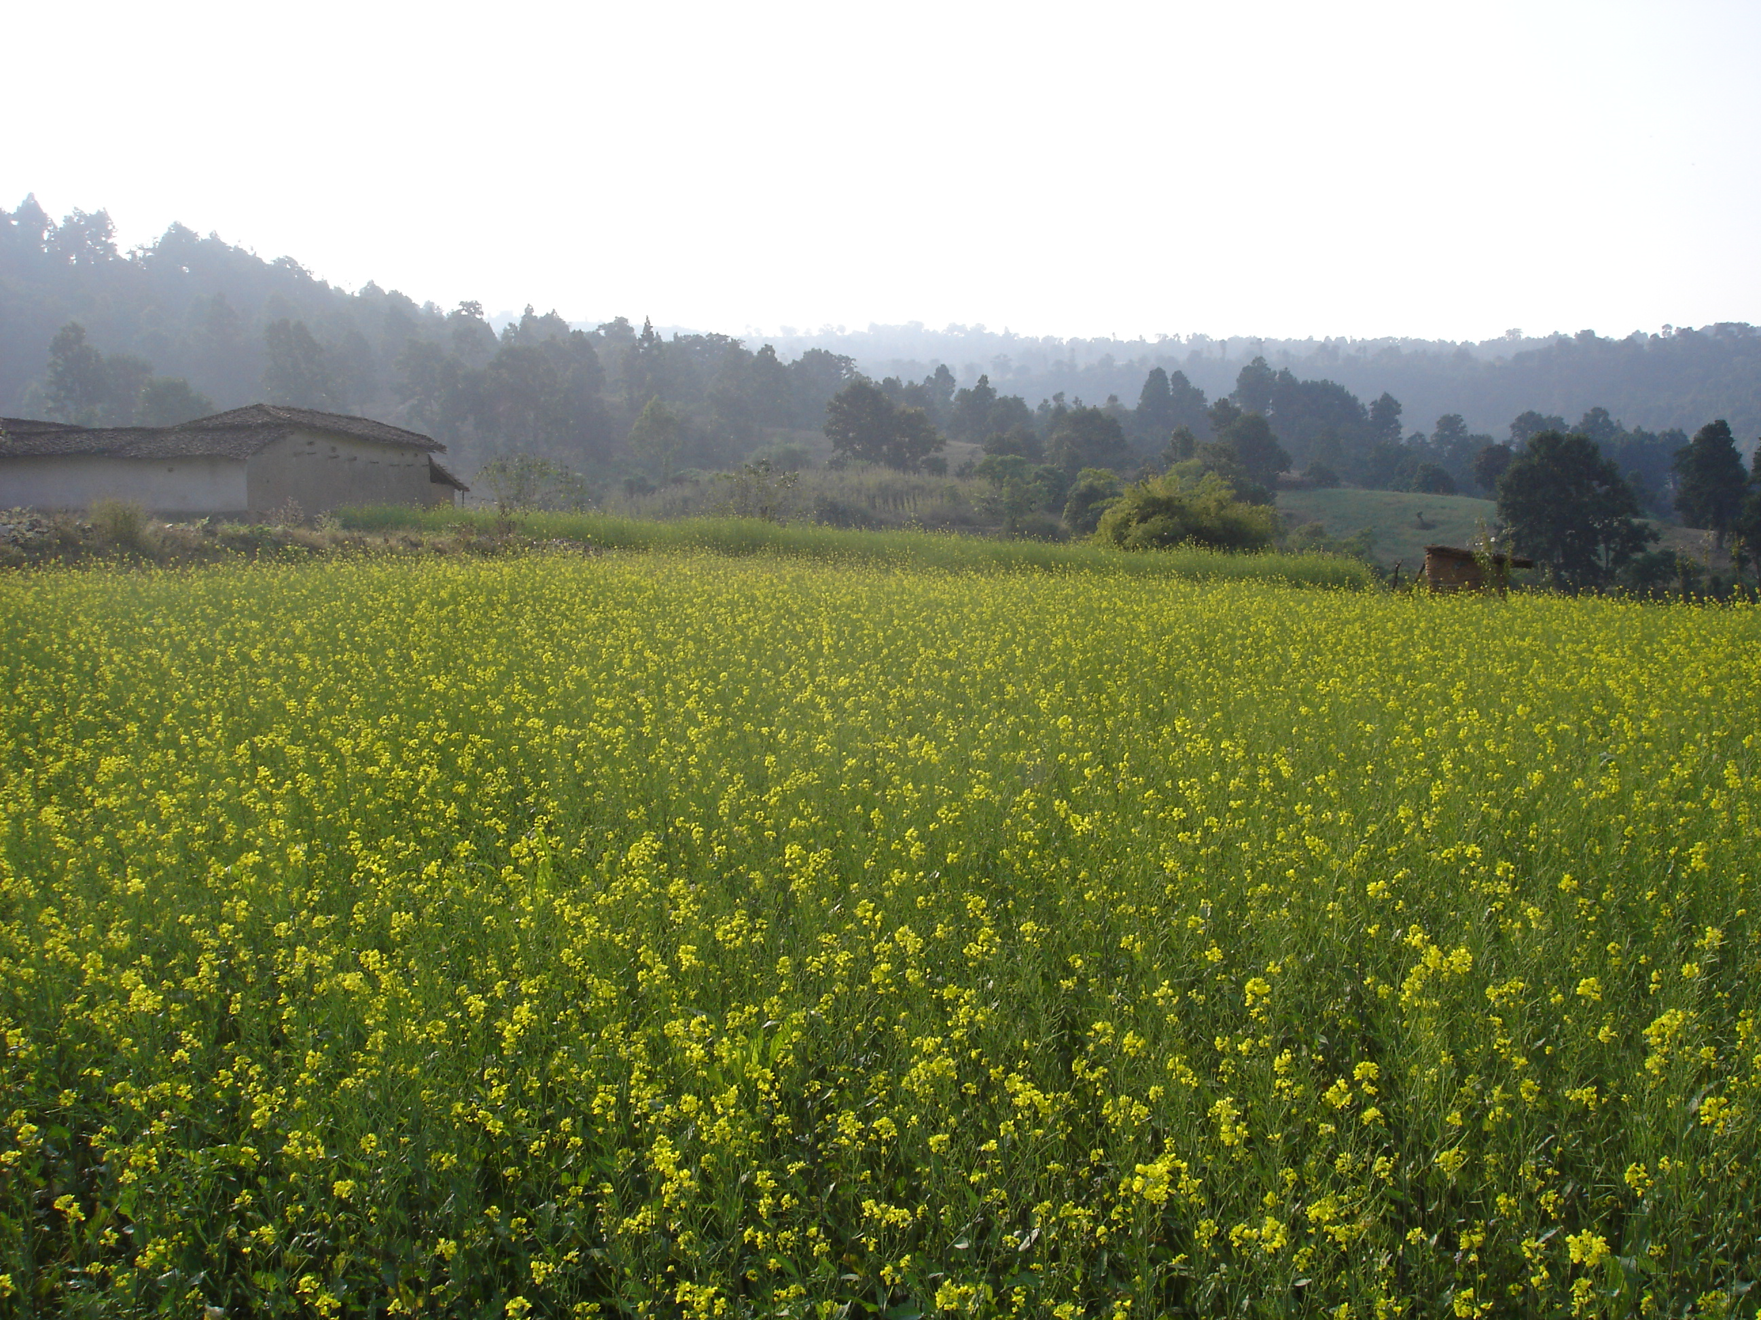


Putting the Quality into ‘Quality of Life’: the Contribution of Qualitative Methods to Assessing Wellbeing in Zambia and India
Paper to Development Studies Association
3 November 2012
Sarah C. White and Shreya Jha
University of Bath

Slide 2
The Field of Wellbeing
Wellbeing in development currently two main trajectories:
  National level ‘beyond GDP’ statistical measures of progress
  Community/individual level research and some project M&E
Wellbeing in development builds on long tradition of broadening vision of development (‘beyond economics’) and range of voices (‘bottom up’ perspectives and participatory approaches)
Subjective dimension is signature to wellbeing but not new – eg work on gender and empowerment
Broader field of happiness, quality of life and wellbeing:
  Dauntingly large number of studies
  Overwhelmingly quantitative
  Dominated by measures not concepts
  Expert/elite capture

Slide 3
Reclaiming the qualitative
This paper reports on on-going mixed method research in India and Zambia to argue the vital contribution of qualitative approaches to the study of wellbeing:
  improving data quality and problem-solving
  strengthen analysis and interpretation of results
  deepening conceptual, ontological and political debate

Slide 4
Points of Reference
Kanbur and Shaffer (2007) note value of mixed methods in poverty analysis, but also tensions which derive from different philosophical standpoints
Graham (2011) notes of the ‘does money make you happy’ debates that much of the dispute can be traced to the methods used in different studies
Camfield et al. (2009) describe discrepancies between qualitative and quantitative data from same subjects
  ‘Qualitative approaches… foreground the presence of both the respondent and the researcher, which highlights the fallibility of all data collection by emphasising their role in its “co-creation” ‘ (Camfield et al., 2009: 8)

Slide 5
The Wellbeing Pathways project
Ambition:
to develop a model of wellbeing that is grounded in the South (more like) how people there think and talk and feel and act
to explore the relationships between poverty and wellbeing – both quantitatively (survey) and qualitatively (interviews)
Research:
in marginalised rural communities, Zambia and India
two rounds of fieldwork of 3-4 months in each country
In each location and each round 350 respondents: 150 couples (husbands and wives separately) and 50 women heading households

Slide 6
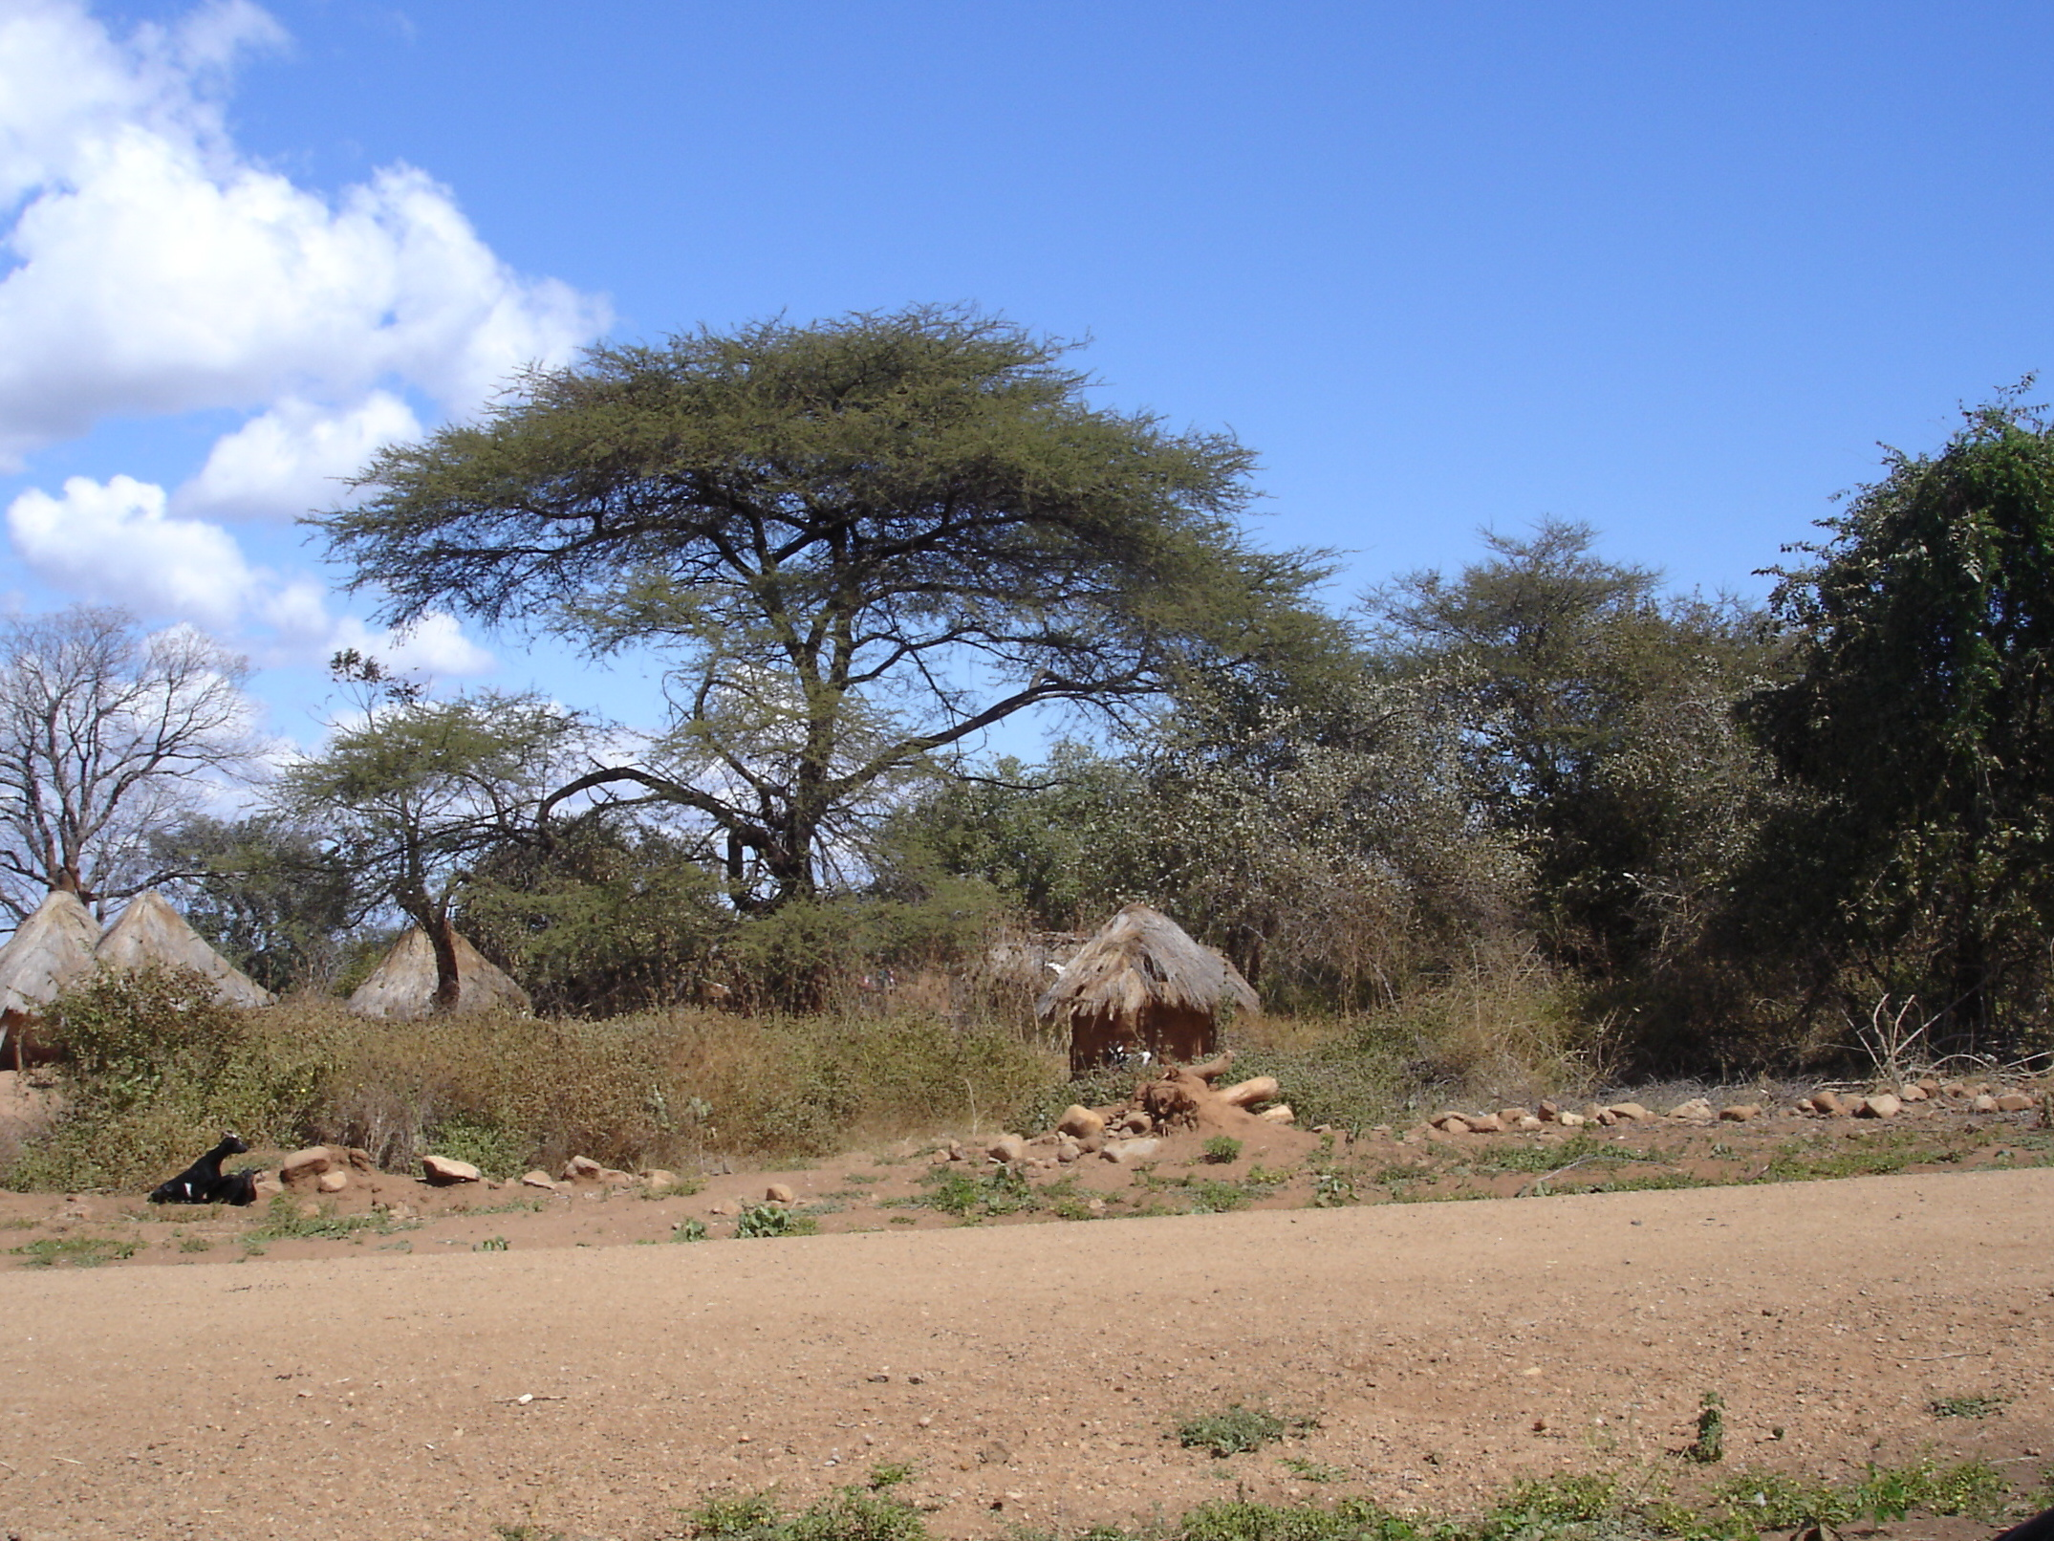
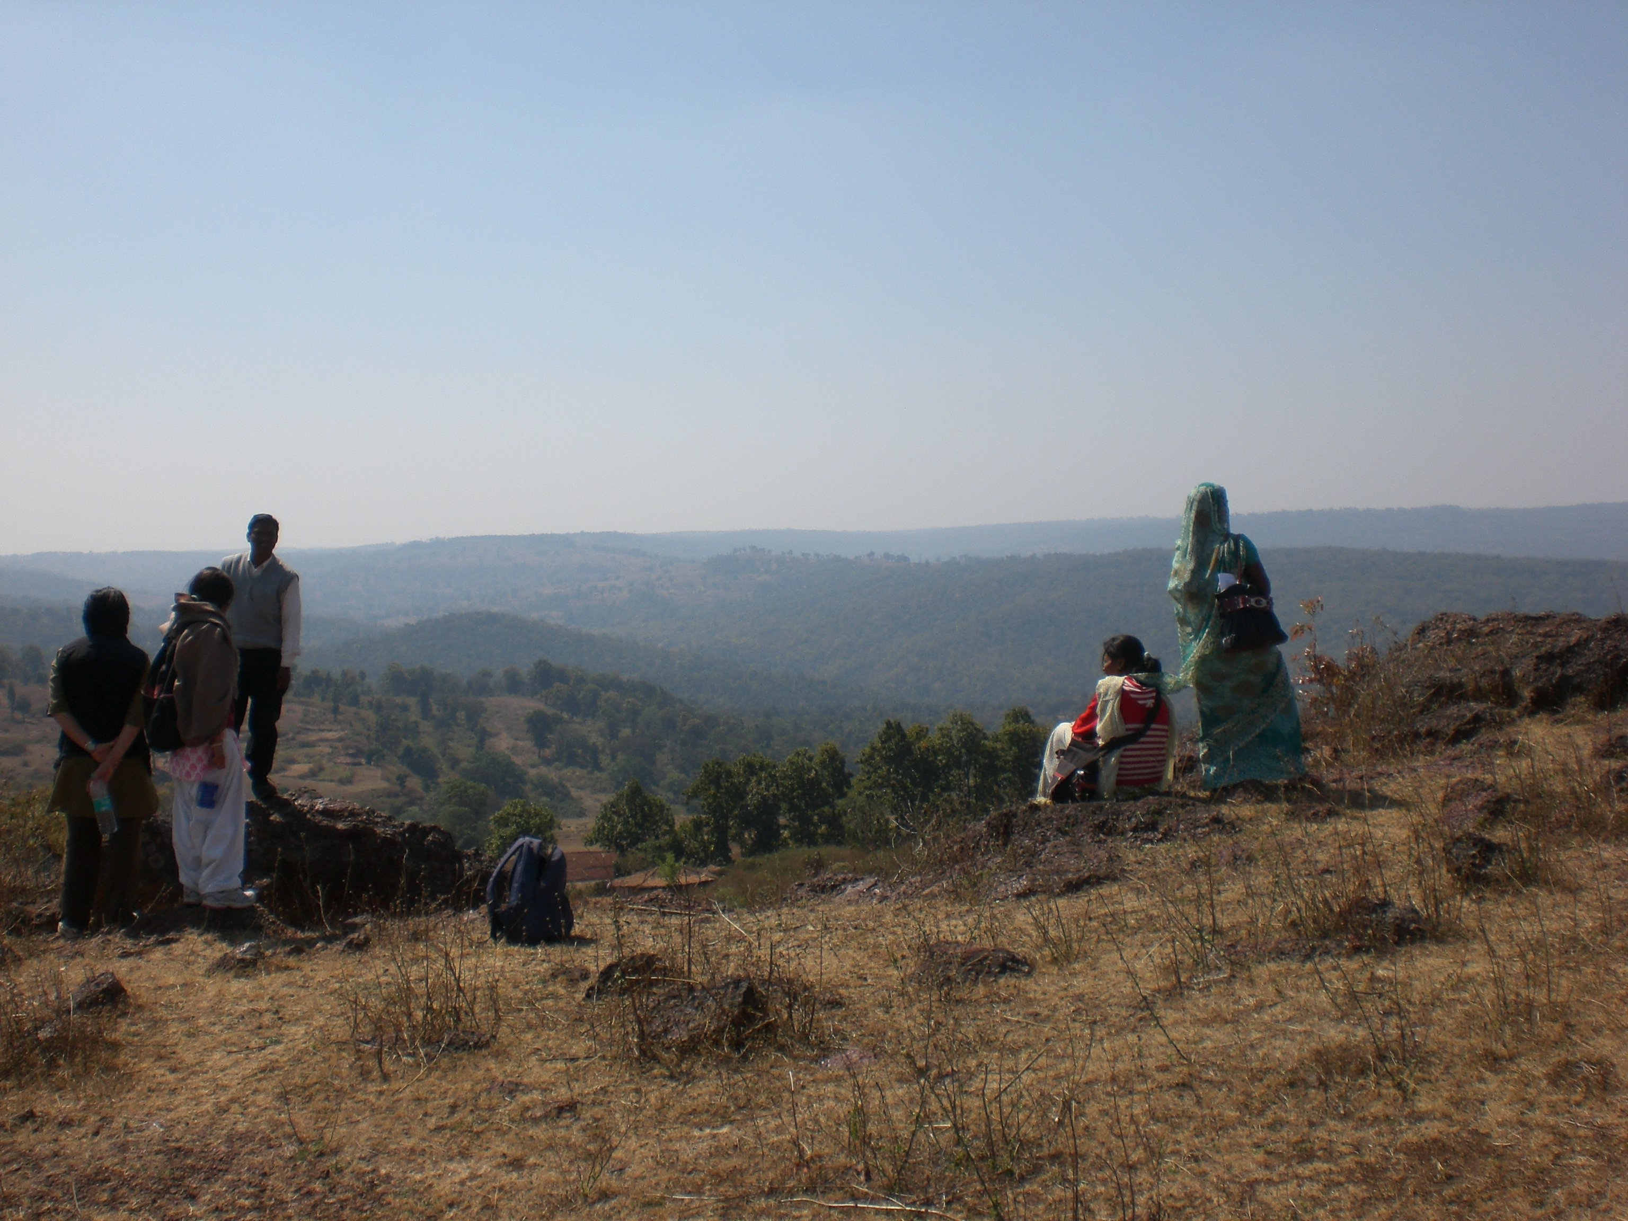
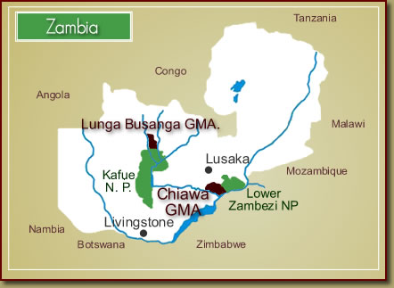
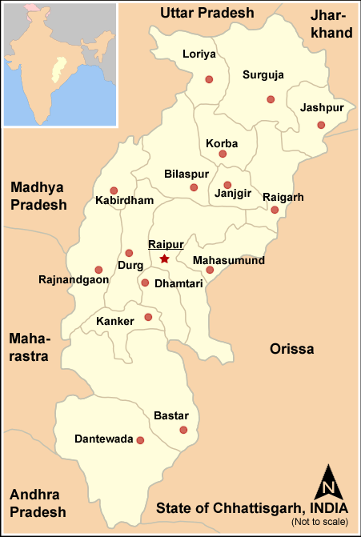
The Sites
Chiawa
Sarguja, Chhattisgarh

Slide 7
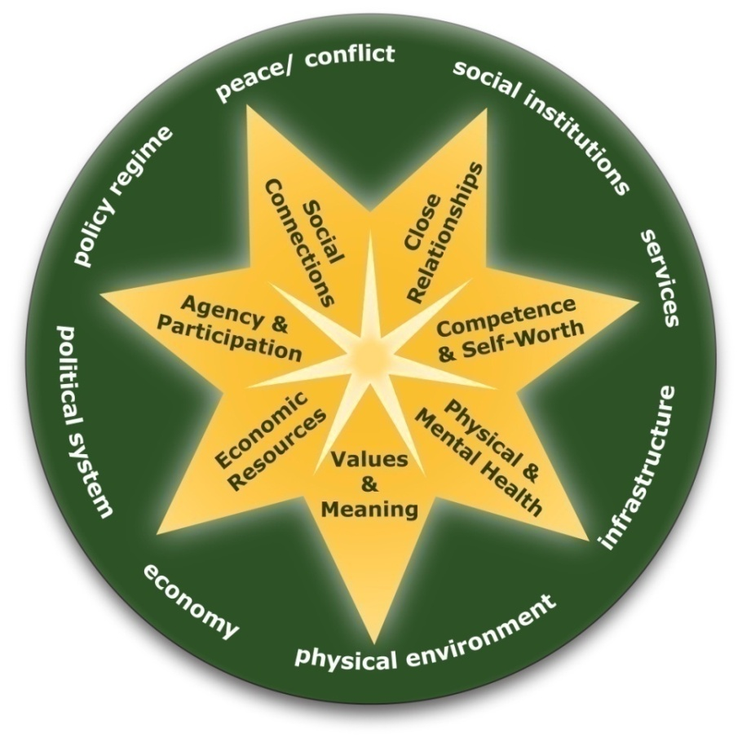
Wellbeing Pathways model
Seven domains (closely interacting)
Wider environment which enables or constrains wellbeing
‘objective’ conditions of people’s lives (via self-report) plus
inner wellbeing:
  beyond satisfaction
  how people feel they can be or what
  they feel they can do, in each domain
  distinct in concept and methods from Subjective Well-being (SWB) or
  subjective quality of life
  allows fluid associations between mind,
  body and spirit, recognising cultural constructions differ

Slide 8
Improve data quality through survey design
Quantitative approaches tend to emphasise output
Qualitative pay more attention to input and process
Designing the survey
Initial consultation on local issues
Intensive grounding and piloting – 10 weeks in all
To ensure data quality (and ethical research practice):
  only include what we think we will use
  don’t ask for unnecessary detail that makes answering onerous
  make the process of doing the survey as conversational as possible
  phrase items as closely as possible to the ways that people talk
  pay attention to how people are thinking and talking about their lives
Research officer present throughout, regular team meetings to raise spirits, ensure data quality, extend local researchers’ skills

Slide 9
Qualitative Problem-Solving
Statistical analysis of 1st round data from Zambia showed it didn’t come together as we had hoped (skewness and kurtosis so no factor analysis possible)
Qualitative reflection identified problems:
  ‘I do not get government assistance at the right time’
  high scores for close relationships (right answer)
  ‘strongly!’ (pattern of questioning)
  acquiescence bias (+ve/-ve loading of statement)
Changed for India:
  some to objective sections
  Questions not statements and responses
  Range of standard examples agreed
And seven domain model statistically validated!

Slide 10
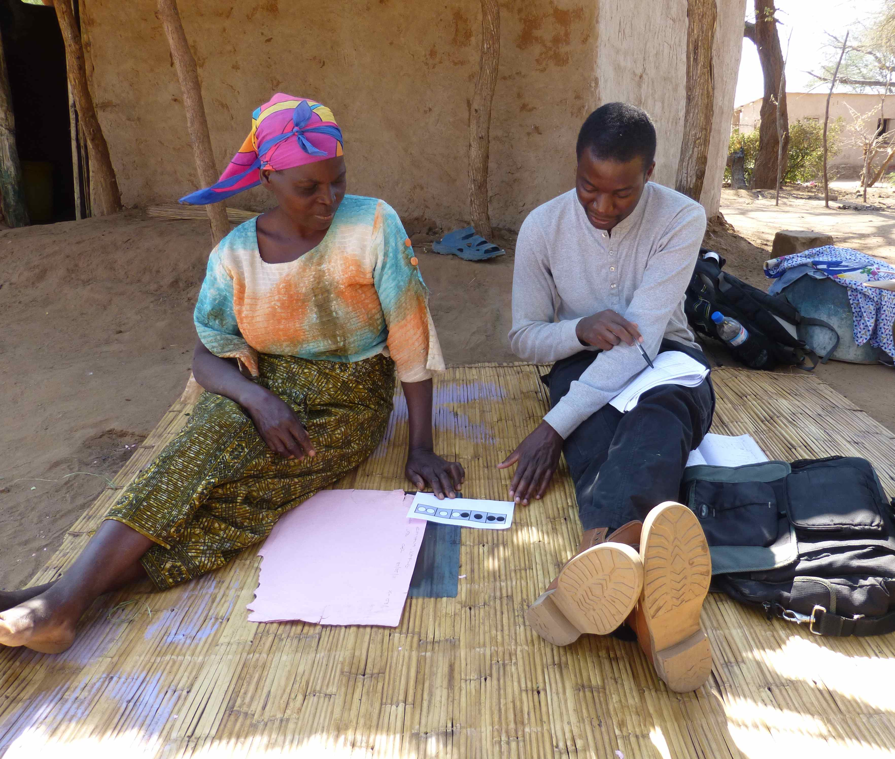
Strengthening analysis and interpretation of results

Slide 11
SWB in Calcutta : Main Findings
Biswas-Diener and Diener, 2001; 2006
Lower satisfaction scores re material domains (except food)
High scores in rating self and social, in particular:
  2001 (scores out of 3): family (2.50), friends (2.40), morality (2.58)
  2006 (scores out of 7): social satisfaction (5.08); self (5.77); intelligence (5.85); family (5.93)
‘while the poor of Calcutta do not lead enviable lives, they do lead meaningful lives. They capitalize on the non-material resources available to them and find satisfaction in many areas of their lives’ (B-D&D 2001: 349)
good social relationships may buffer negative effects of material deprivation (2006:201)

Slide 12
Patterns of Wellbeing
Mean domain scores: Sarguja, 2011
(close relationships 4.6/5; mean of other means 2.9)
Chiawa items on family relations average 4.4 beside overall mean of 3.31
But both places much domestic violence and unhappiness

Slide 13
Close relationships
Not appropriate to talk so directly
Sarguja:
To questions about the care for her in her family:
A) She always worries about her husband going to another village and that he will drink there and maybe fall down and what will happen to him. If her husband was at home then she would have cooked for him and fed him and known where he was safe at home, but if he is out then she worries about him and can’t sleep.
B) She was married in front of several people.
C) Surely he loves her since they have been living together so long and have had five children together!
Strong positivity bias

Slide 14
Social Connections
Asked about general helpfulness people gave very positive responses, often referring specifically to their own neighbourhood, but saying they couldn’t comment about people beyond their neighbourhood.
In general scores about social connections rather low: Sarguja 3 of 4 items below mid-point. 2 of these strong gender pattern (men doing better)
Stronger demand on connections, lower the score
Chiawa also strong gender pattern (3 of 6 significant)
Strong country contrast on people were actively seeking their harm. Sarguja 4.35; Chiawa 2.11 – men highest. Witchcraft, while Sarguja mainly natural harms
Qualitative confirms quantitative in showing ambivalence of social relations – e.g. demands of reciprocity

Slide 15
Deepening the Debate
Questioning the frame
Epistemology – do the methods co-construct the data?
Ontology – selves as fixed and WB as something people ‘have’ or ‘seek to achieve’?
Surveys as disciplining respondents:
direct answers; abstracting questions;
'Evolutionism, functionalism, diffusionism - whatever the method, all express otherness in the name of sameness, reduce the different to the already known, and thus fundamentally escape the task of making sense of other worlds.' (Mudimbe, 1988: 72-3).

Slide 16
Thanks!
To the Wellbeing Pathways Team, whose work this presentation reflects:
  UK based: Stanley O. Gaines Jr., Nina Marshall, Susanna Siddiqui,
  Zambia based: Hodi; Jonnathan Mtonga, Joseph Kajiwa, Stephen Kalio, Kelvin Matesamwa, Goodson Phiri
  India based: Chaupal and Gangaram Paikra; Pritam Das, Usha Kujur, Kanti Minjh, Dinesh Tirkey, Abhay Xaxa
  The Economic and Social Research Council/Department For International Development Joint Scheme for Research on International Development (Poverty Alleviation) grant number RES-167-25-0507 ES/H033769/1

